Slide 1

Basic FPGA
Architecture

Slide 2
Objectives
After completing this module, you will be able to:
Identify the basic architectural resources of the Virtex™-II FPGA
List the differences between the Virtex-II, Virtex-II Pro, Spartan™-3, and Spartan-3E devices
List the new and enhanced features of the new Virtex-4 device family
Notes:
Note, this module addresses the various resources available on Xilinx devices, and it specifically discusses the resources on the Virtex -II device. For information on how to use these resources in your design (such as whether to instantiate or to infer these resources), refer to the “HDL Coding Style” module in the Designing for Performance course.

Slide 3
Outline
Overview
Slice Resources
I/O Resources
Memory and Clocking
Spartan-3, Spartan-3E, and Virtex-II Pro Features
Virtex-4 Features
Summary
Appendix

Slide 4
Overview
All Xilinx FPGAs contain the same basic resources
  Slices (grouped into CLBs)
    Contain combinatorial logic and register resources
  IOBs
    Interface between the FPGA and the outside world
  Programmable interconnect
  Other resources
    Memory
    Multipliers
    Global clock buffers
    Boundary scan logic
Notes:
IOBs = Input/Output Blocks

Slide 5
Virtex-II Architecture
Block SelectRAM™
resource
I/O Blocks (IOBs)
Programmable interconnect
Dedicated multipliers
Configurable
Logic Blocks (CLBs)
Virtex™-II architecture’s core voltage
operates at 1.5V
Clock Management (DCMs, BUFGMUXes)
Notes:
This is a graphical view of the resources of an FPGA (specifically, resources available for the Virtex™-II device).
The block SelectRAM™ resources are located between the CLBs, next to the dedicated multiplier. Programmable interconnect connects the CLBs. The CLBs contain combinatorial logic functions and sequential elements. Most, if not all, of the logic in a design is contained in CLBs.
The I/Os interface the FPGA with other devices on the system board. The core voltage of Virtex-II is 1.5V. The I/Os can operate at different voltages, depending on the I/O type you choose.

Slide 6
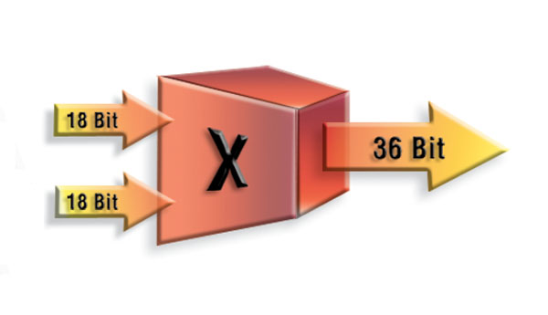
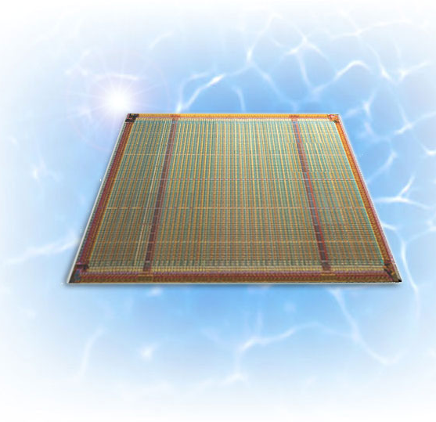
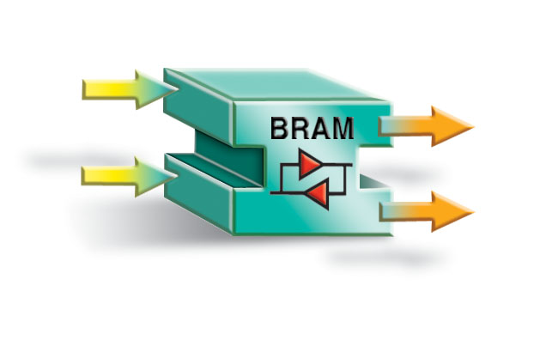
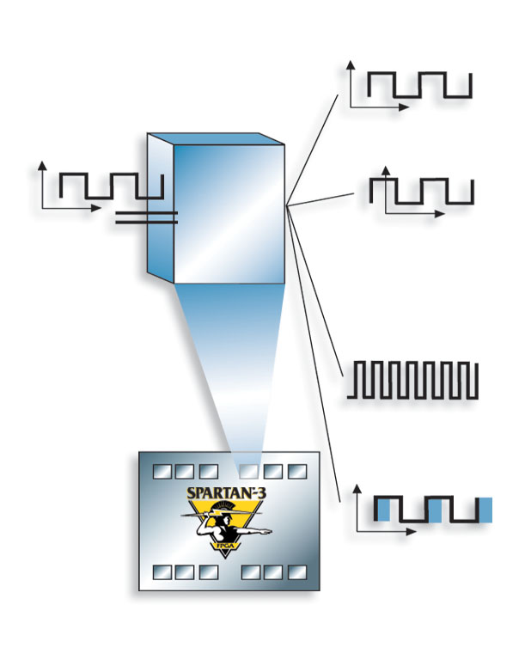
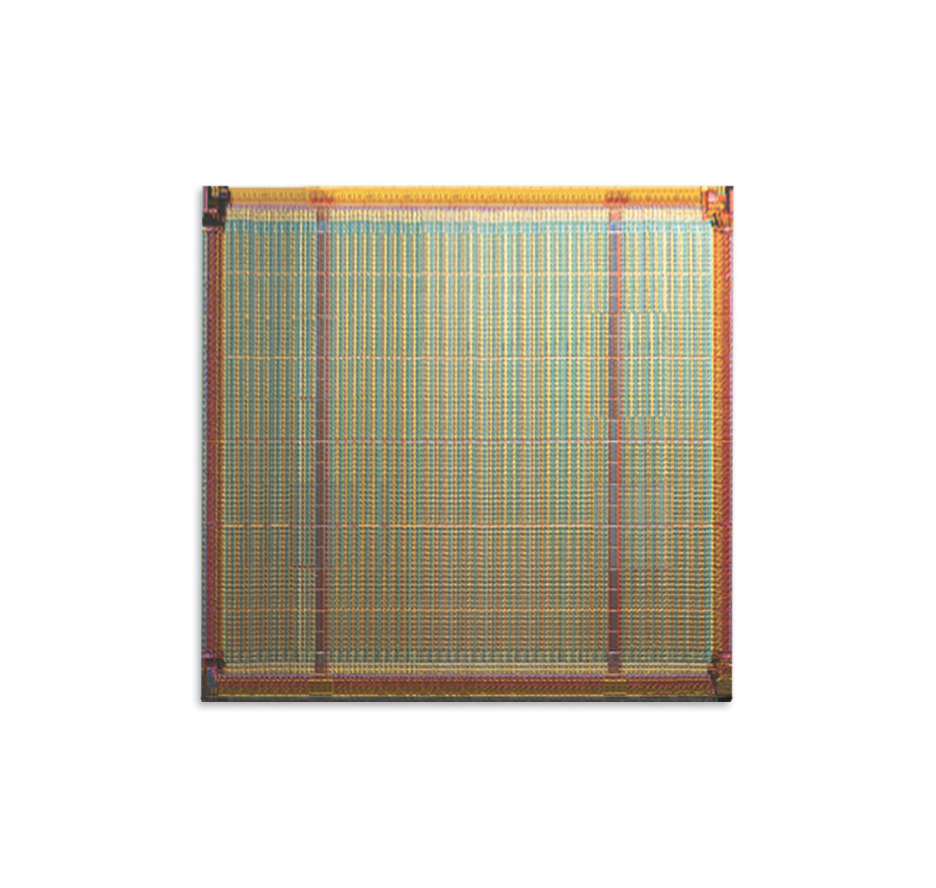
The Spartan-3 Solution
A New Class of Spartan FPGAs
18x18 bit Embedded Pipelined Multipliers for efficient DSP
Configurable 18K Block RAMs + Distributed RAM
Spartan-3
Bank 0
Bank 3
Bank 1
Bank 2
4 I/O Banks,
Support for
all I/O Standards including
PCI, DDR333,
RSDS, mini-LVDS
Up to eight on-chip Digital Clock Managers to support multiple system clocks

Slide 7



Virtex-II Pro Platform FPGA
3.125 Gbps Multi-Gigabit Transceivers (MGTs)
Supports 10 Gbps standards
Up to 24 per device
MGT
MGT
Fabric
IP-Immersion™ Fabric
Active Interconnect™
18Kb Dual-Port RAM
Xtreme™ Multipliers
16 Global Clock Domains
PowerPC 405 Core
300+ MHz / 450+ DMIPS
Performance
Up to 4 per device
MGT
MGT

Slide 8
Outline
Overview
Slice Resources
I/O Resources
Memory and Clocking
Spartan-3, Spartan-3E, and Virtex-II Pro Features
Virtex-4 Features
Summary
Appendix
Notes:
In the following slides, most of the resources described are automatically used by the synthesis or implementation tool, but we are introducing the resources so that you know what is available. It is important to know which resources are available so you can write your code to take advantage of these resources—especially if you are creating customized functions for your design.

Slide 9
Slices and CLBs
Each Virtex™-II CLB contains four slices
  Local routing provides feedback between slices in the same CLB, and it provides routing to
  neighboring CLBs
  A switch matrix provides access
  to general routing resources
COUT
COUT
Switch
Matrix
BUFT
BUF T
Slice S3
Slice S2
SHIFT
Slice S1
Slice S0
Local Routing
CIN
CIN
Notes:
CLB = Configurable Logic Block

Slide 10
Simplified Slice Structure
Each slice has four outputs
  Two registered outputs, two non-registered outputs
  Two BUFTs associated
  with each CLB, accessible
  by all 16 CLB outputs
Carry logic runs vertically,
up only
  Two independent carry chains per CLB
Slice 0
LUT
PRE
Carry
D
Q
CE
CLR
LUT
Carry
PRE
D
Q
CE
CLR
Notes:
The major parts of a slice include two Look-Up Tables (LUTs), two sequential elements, and carry logic.
The LUTs are known as the F LUT and the G LUT. The sequential elements can be programmed to be either registers or latches.
The next several slides cover the LUT, the carry logic, and the flip-flops in detail.

Slide 11
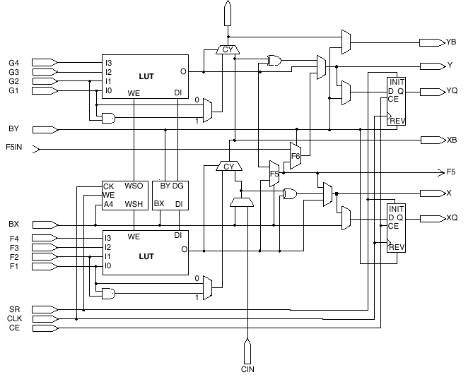
Detailed Slice Structure
The next few slides discuss the slice features
  LUTs
  MUXF5, MUXF6,
  MUXF7, MUXF8
  (only the F5 and
  F6 MUX are shown
  in this diagram)
  Carry Logic
  MULT_ANDs
  Sequential Elements
Notes:
The diagram pictured in this slide is similar to a slice viewed in the FPGA Editor tool.
Many of the multiplexers shown are for configuration purposes and do not perform user logic. For example, there is a multiplexer that selects the source of the D input for each flip-flop in the slice.

Slide 12
Look-Up Tables
Combinatorial logic is stored in Look-Up Tables (LUTs)
  Also called Function Generators (FGs)
  Capacity is limited by the number of inputs, not by the complexity
Delay through the LUT is constant
A | B | C | D | Z
0 | 0 | 0 | 0 | 0
0 | 0 | 0 | 1 | 0
0 | 0 | 1 | 0 | 0
0 | 0 | 1 | 1 | 1
0 | 1 | 0 | 0 | 1
0 | 1 | 0 | 1 | 1
 | . | . | .
1 | 1 | 0 | 0 | 0
1 | 1 | 0 | 1 | 0
1 | 1 | 1 | 0 | 0
1 | 1 | 1 | 1 | 1
Combinatorial Logic
A
B
Z
C
D

Slide 13
Connecting Look-Up Tables
MUXF8 combines the two MUXF7 outputs (from the CLB above or below)
CLB
F8
Slice S3
F5
MUXF6 combines slices S2 and S3
F6
Slice S2
F5
MUXF7 combines the two MUXF6 outputs
F7
Slice S1
F5
MUXF6 combines slices S0 and S1
Slice S0
F6
F5
MUXF5 combines LUTs in each slice
Notes:
Look-Up Tables (LUTs) are also called Function Generators (FGs).
Two CLBs can create a function of 79 inputs. This function uses all of the LUTs, F5MUX, F6MUX, and F7MUX resources in both CLBs, plus one F8MUX. Not all combinations of the 79 inputs will be available, but it is possible to have a 79-input function.

Slide 14
Fast Carry Logic
Simple, fast, and complete arithmetic Logic
  Dedicated XOR gate for single-level sum completion
  Uses dedicated routing resources
  All synthesis tools can infer carry logic
COUT
COUT
To S0 of the next CLB
To CIN of S2 of the next CLB
SLICE S3
First Carry Chain
CIN
COUT
SLICE S2
SLICE S1
CIN
Second Carry Chain
COUT
SLICE S0
CIN
CIN
CLB

Slide 15
MULT_AND Gate
Highly efficient multiply and add implementation
  Earlier FPGA architectures require two LUTs per bit to perform the multiplication and addition
  The MULT_AND gate enables an area reduction by performing the
  multiply and the add in one LUT per bit
A
LUT
CY_MUX
CO
S
DI
CI
CY_XOR
MULT_AND
A x B
LUT
B
LUT
Notes:
The Virtex™-II software has a two-input AND gate associated with each function generator (MULT_AND). Therefore, multiplication and addition can be completed at the same time in the same slice, improving the performance of multipliers and Digital Signal Processing (DSP) applications.
This resource is the same as the MULT_AND in the Virtex devices.
The Virtex-II software also contains dedicated multipliers, which will be covered later in this module.
The MULT_AND should be used for small multipliers or when the dedicated multipliers are all being used. The MULT_AND may also be faster than the Mult 18x18, depending on the function being implemented—for example, Multiply and Accumulate (MAC).

Slide 16
Flexible Sequential Elements
Either flip-flops or latches
Two in each slice; eight in each CLB
Inputs come from LUTs or from an independent CLB input
Separate set and reset controls
  Can be synchronous or asynchronous
All controls are shared within a slice
  Control signals can be inverted locally within a slice
_1
FDRSE
D
S
Q
CE
R
FDCPE
D
PRE
Q
CE
CLR
LDCPE
D
PRE
Q
CE
G
CLR
Notes:
The Virtex™-II register uses separate inputs to drive the set and reset pins. Therefore, each register can have both set and reset (reset takes precedence).
These resources are the same as the flip-flops in the Virtex devices.
For a list of possible configurations for the sequential elements, consult the Libraries Guide. The Libraries Guide contains a list of all of the possible primitives and macros that Xilinx has to offer. All primitives and macros are listed in alphabetical order and include a schematic drawing, port names (for HDL instantiation), a functional description, and a truth table on the behavior of the component.
The Libraries Guide is located at www.xilinx.com under the Support link. In the left column (under the Answers Database search), there is a link to Software Manuals. Choose a viewing format to view a list of available books and documents. The Libraries Guide is in the list of books and documents. It is a very useful book!

Slide 17
Shift Register LUT (SRL16CE)
Dynamically addressable serial shift registers
  Maximum delay of 16 clock cycles per LUT (128 per CLB)
  Cascadable to other LUTs or CLBs for longer shift registers
    Dedicated connection from Q15 to D input of the next SRL16CE
  Shift register length can
  be changed
  asynchronously
  by toggling address A
LUT
D
D
Q
CE
CE
CLK
D
Q
CE
D
Q
Q
CE
LUT
D
Q
CE
A[3:0]
Q15 (cascade out)
Notes:
Note that the SRL16CE can only be loaded serially. As data is presented to be loaded, the previously loaded data will be shifted down.
There are no set or reset capabilities, so the SRL16CE does not behave the same as an implementation with registers.
This resource is similar to the SRL16E in the Virtex™ devices, with the addition of the cascade feature.

Slide 18
Shift Register LUT Example
The SRL can be used to create a No Operation (NOP)
  This example uses 64 LUTs (8 CLBs) to replace 576 flip-flops (72 CLBs) and associated routing and delays
12 Cycles
Operation A
Operation B
64
4 Cycles
8 Cycles
64
Operation C
Operation D - NOP
3 Cycles
9 Cycles
Paths are Statically
Balanced
12 Cycles
Notes:
Register-rich FPGAs allow you to add pipeline stages to increase clock frequencies. All datapaths must be balanced to maintain the desired functionality. This slide shows an example of how using SRL can save many registers when SRL is used to balance pipelines.
Because there are so many registers in FPGAs, pipelining is an effective way of designing to increase design performance. Because pipelines can sometimes become unbalanced when too much logic must be generated, it is necessary to delay some of the signals. One of the best uses of the SRL is to add delay to balance pipelines.

Slide 19
Outline
Overview
Slice Resources
I/O Resources
Memory and Clocking
Spartan-3, Spartan-3E, and Virtex-II Pro Features
Virtex-4 Features
Summary
Appendix

Slide 20
IOB Element
Input path
  Two DDR registers
Output path
  Two DDR registers
  Two 3-state enable
  DDR registers
Separate clocks and
clock enables for I and O
Set and reset signals
are shared
IOB
Reg
Input
DDR MUX
OCK1
Reg
Reg
ICK1
3-state
Reg
OCK2
ICK2
Reg
DDR MUX
OCK1
PAD
Reg
OCK2
Output
Notes:
You are not required to use the registers in the IOB in Double Data Rate mode.
Clocking the DDR registers: You can also use any pair of DCM outputs that are 180 degrees out of phase (CLK90 / CLK270, CLK2X / CLK2X180, CLKFX / CLKFX180).

Slide 21
SelectIO Standard
Allows direct connections to external signals of varied voltages and thresholds
  Optimizes the speed/noise tradeoff
  Saves having to place interface components onto your board
Differential signaling standards
  LVDS, BLVDS, ULVDS
  LDT
  LVPECL
Single-ended I/O standards
  LVTTL, LVCMOS (3.3V, 2.5V, 1.8V, and 1.5V)
  PCI-X at 133 MHz, PCI (3.3V at 33 MHz and 66 MHz)
  GTL, GTLP
  and more!
Notes:
There are two ways to use I/O standards in your design:
1) Use the PACE tool to assign standards
2) Use the IOSTANDARD attribute in your source code
3) Instantiate the I/O buffer in your design
The I/O standards are industry standards. You can find the definition of all of the standards in the Virtex-II Handbook. Some definitions are listed below:
LDT: Lightning Data Transport
LVDS: Low Voltage Differential Signaling
BLVDS: Bus LVDS
LVPECL: Low Voltage Positive Emitter Coupled Logic
LVTTL: Low Voltage TTL
GTL: Gunning Transceiver Logic Terminated

Slide 22
Digital Controlled
Impedance (DCI)
DCI provides
  Output drivers that match the impedance of the traces
  On-chip termination for receivers and transmitters
DCI advantages
  Improves signal integrity by eliminating stub reflections
  Reduces board routing complexity and component count by eliminating external resistors
  Eliminates the effects of temperature, voltage, and process variations by using an internal feedback circuit
Notes:
Stub reflections occur when the termination resistor is too far away from the end of the transmission line. With DCI, the resistors are as close to the input buffer or output buffer as possible, thereby eliminating stub reflections.
For more information on DCI and usage rules, refer to the “Advanced FPGA Architecture” module in the Designing for Performance course.

Slide 23
Outline
Overview
Slice Resources
I/O Resources
Memory and Clocking
Spartan-3, Spartan-3E, and Virtex-II Pro Features
Virtex-4 Features
Summary
Appendix

Slide 24
Other Virtex-II Features
Distributed RAM and block RAM
  Distributed RAM uses the CLB resources (1 LUT = 16 RAM bits)
  Block RAM is a dedicated resources on the device (18-kb blocks)
Dedicated 18 x 18 multipliers next to block RAMs
Clock management resources
  Sixteen dedicated global clock multiplexers
  Digital Clock Managers (DCMs)

Slide 25
Distributed SelectRAM Resources
Uses a LUT in a slice as memory
Synchronous write
Asynchronous read
  Accompanying flip-flops
  can be used to create
  synchronous read
RAM and ROM are initialized during
configuration
  Data can be written to RAM
  after configuration
Emulated dual-port RAM
  One read/write port
  One read-only port
RAM16X1S
D
LUT
WE
WCLK
A0
O
A1
A2
A3
RAM32X1S
RAM16X1D
D
D
WE
WE
Slice
WCLK
WCLK
A0
O
A0
SPO
LUT
A1
A1
A2
A2
A3
A3
A4
DPRA0
DPO
DPRA1
LUT
DPRA2
DPRA3
Notes:
The table below lists the number of LUTs required to implement different sizes of RAM (S = single-port RAM, D = dual-port RAM).
Memories that are deeper than 32 words will require additional logic for bank selection and output multiplexing.
RAM Size # of LUTs
16 x 1S 1
16 x 1D 2
32 x 1S 2
32 x 1D 4
64 x 1S 4
64 x 1D 8
128 x 1S 8

Slide 26
Block SelectRAM Resources
Up to 3.5 Mb of RAM in 18-kb blocks
  Synchronous read and write
True dual-port memory
  Each port has synchronous read and write capability
  Different clocks for each port
Supports initial values
Synchronous reset on output latches
Supports parity bits
  One parity bit per eight data bits
18-kb block SelectRAM memory
DIA
DIPA
ADDRA
WEA
ENA
SSRA
DOA
CLKA
DOPA
DIB
DIPB
ADDRB
WEB
ENB
SSRB
DOB
CLKB
DOPB
Notes:
Block SelectRAM™ resources are dedicated resources on the silicon.
RAMs can be given an initial value. Many “initialization” attributes are associated with the block SelectRAM resources:
INIT_xx: Numbered attributes (00 - 3F) that specify the initial memory data contents. Each INIT_xx attribute is a 64-digit hex number.
INITP_xx: Numbered attributes (00 - 07) that specify the initial memory parity contents. Each INITP_xx attribute is a 64-digit hex number.
INIT_A/INIT_B: Specifies the initial value of the RAM output latches after configuration.
SRVAL_A/SRVAL_B: Specifies the value of the RAM output latches after SSRA/SSRB is asserted.
INIT and SRVAL attributes are specified as 1-hex numbers.
For more information on RAM initialization, refer to the data sheet.

Slide 27
Dedicated Multiplier Blocks
18-bit twos complement signed operation
Optimized to implement Multiply and Accumulate functions
Multipliers are physically located next to block SelectRAM™ memory
Data_A
(18 bits)
18 x 18
Multiplier
4 x 4 signed
8 x 8 signed
12 x 12 signed
18 x 18 signed
Output
(36 bits)
Data_B
(18 bits)

Slide 28
Global Clock Routing Resources
Sixteen dedicated global clock multiplexers
  Eight on the top-center of the die, eight on the bottom-center
  Driven by a clock input pad, a DCM, or local routing
Global clock multiplexers provide the following:
  Traditional clock buffer (BUFG) function
  Global clock enable capability (BUFGCE)
  Glitch-free switching between clock signals (BUFGMUX)
Up to eight clock nets can be used in each clock region of the device
  Each device contains four or more clock regions
Notes:
Note that the 16 dedicated buffers are designed for clock distribution only.
The clock input pads on the Virtex™-II devices can be used for normal I/O signals if they are not being used for clock signals.
Clock regions: the Virtex-II devices are divided into four or more clock regions. Here are examples of what clock regions look like in differently sized devices.
For more information about clock distribution and clock regions, refer to the “Clocking Techniques” module in the Advanced FPGA Implementation course.

Slide 29
Digital Clock Manager (DCM)
Up to twelve DCMs per device
  Located on the top and bottom edges of the die
  Driven by clock input pads
DCMs provide the following:
  Delay-Locked Loop (DLL)
  Digital Frequency Synthesizer (DFS)
  Digital Phase Shifter (DPS)
Up to four outputs of each DCM can drive onto global clock buffers
  All DCM outputs can drive general routing
Notes:
For more information on the DCM, refer to the “Designing with the DCM” module in the Designing for Performance course.

Slide 30
Outline
Overview
Slice Resources
I/O Resources
Memory and Clocking
Spartan-3, Spartan-3E, and Virtex-II Pro Features
Virtex-4 Features
Summary
Appendix

Slide 31
Spartan-3 versus Virtex-II
More I/O pins per package
Only one-half of the slices support RAM or SRL16s (SLICEM)
Fewer block RAMs and multiplier blocks
  Same size and functionality
Eight global clock multiplexers
Two or four DCM blocks
No internal 3-state buffers
  3-state buffers are in the I/O
Lower cost
Smaller process = lower core voltage
  .09 micron versus .15 micron
  Vccint = 1.2V versus 1.5V
Different I/O standard support
  New standards: 1.2V LVCMOS, 1.8V HSTL, and SSTL
  Default is LVCMOS, versus LVTTL
Notes:
SLICEM is described on the next page.
DCMs: The smallest Spartan™-3 device (XC3S50) contains two DCMs. All other devices contain four DCMs. These DCMs are located on the top and bottom edges of the die, above and below the block RAM and multiplier columns.

Slide 32
SLICEM and SLICEL
Each Spartan™-3 CLB contains four slices
  Similar to the Virtex™-II
Slices are grouped in pairs
  Left-hand SLICEM (Memory)
    LUTs can be configured as memory or SRL16
  Right-hand SLICEL (Logic)
    LUT can be used as logic only
Left-Hand SLICEM
Right-Hand SLICEL
COUT
COUT
Switch
Matrix
Slice X1Y1
Slice X1Y0
SHIFTIN
Slice X0Y1
Slice X0Y0
Fast Connects
SHIFTOUT
CIN
CIN

Slide 33
Spartan-3E Features
16 BUFGMUXes on left and right sides
  Drive half the chip only
  In addition to eight global clocks
Pipelined multipliers
Additional configuration modes
  SPI, BPI
  Multi-Boot mode
More gates per I/O than Spartan-3
Removed some I/O standards
  Higher-drive LVCMOS
  GTL, GTLP
  SSTL2_II
  HSTL_II_18, HSTL_I, HSTL_III
  LVDS_EXT, ULVDS
DDR Cascade
  Internal data is presented on a single clock edge

Slide 34
Virtex-II Pro Features
0.13 micron process
Up to 24 RocketIO™ Multi-Gigabit Transceiver (MGT) blocks
  Serializer and deserializer (SERDES)
  Fibre Channel, Gigabit Ethernet, XAUI, Infiniband compliant transceivers, and others
  8-, 16-, and 32-bit selectable FPGA interface
  8B/10B encoder and decoder
PowerPC™ RISC processor blocks
  Thirty-two 32-bit General Purpose Registers (GPRs)
  Low power consumption: 0.9mW/MHz
  IBM CoreConnect bus architecture support
Notes:
The Virtex™-II Pro is made of the same fabric as the Virtex-II family, with the addition of the features listed above.
The RocketIO MGT features a variable-speed full-duplex transceiver. This transceiver allows 622 Mbps to 3.125 Gbps baud transfer rates. For more information, refer to the RocketIO Transceiver User Guide or the Designing with Multi-Gigabit Serial I/O course.
For more information on the Virtex-II Pro devices and features, refer to the Virtex-II Pro Platform FPGA User Guide or the Embedded Systems Development course.

Slide 35
Outline
Overview
Slice Resources
I/O Resources
Memory and Clocking
Spartan-3, Spartan-3E, and Virtex-II Pro Features
Virtex-4 Features
Summary
Appendix

Slide 36
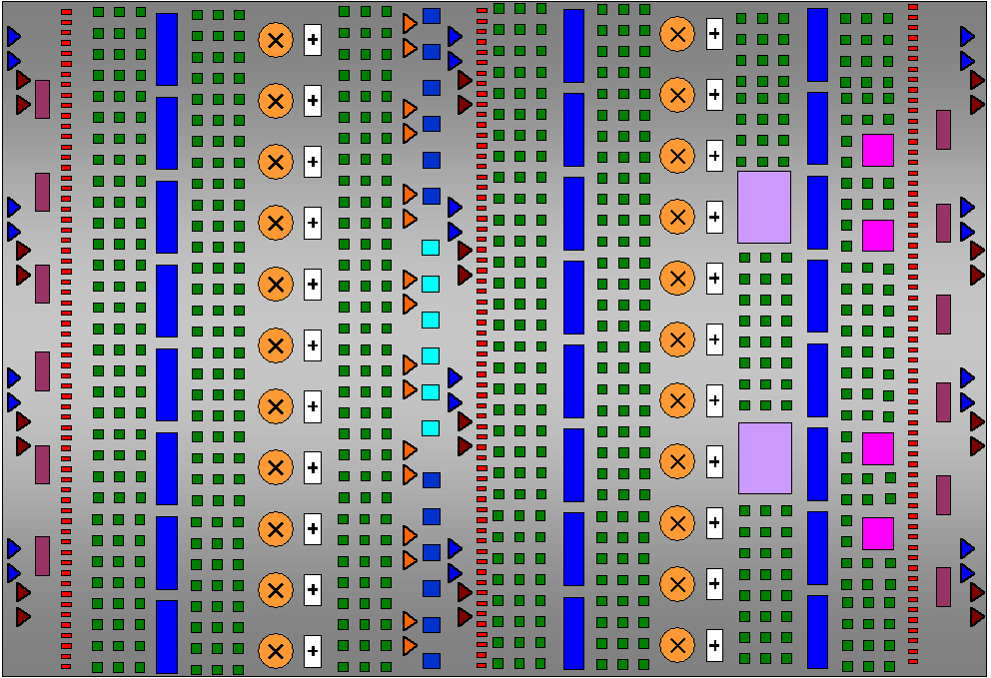
Virtex-4 Architecture Has the Most Advanced Feature Set
RocketIO™
Multi-Gigabit
Transceivers
622 Mbps–10.3 Gbps
Smart RAM
New block RAM/FIFO
Xesium Clocking
Technology
500 MHz
Advanced CLBs
200K Logic Cells
Tri-Mode
Ethernet MAC
10/100/1000 Mbps
XtremeDSP™ Technology Slices
256 18x18 GMACs
PowerPC™ 405
with APU Interface
450 MHz, 680 DMIPS
1 Gbps SelectIO™
ChipSync™ Source synch,
XCITE Active Termination
Notes:
All Xilinx FPGAs contain the same basic resources. Slices, which are grouped into Configurable Logic Blocks, or CLBs, contain combinatorial logic and register resources. Input/Output Blocks, or IOBs interface between the FPGA and the outside world. Programmable interconnect is how the Slices and IOBs communicate with each other. Other resources include: Memory, DSP Slices, clock management components, and IP cores.

Slide 37
Choose the Platform that Best Fits the Application
LX
FX
SX
Resource
Logic
Memory
DCMs
DSP Slices
SelectIO
RocketIO
PowerPC
Ethernet MAC
14K–200K LCs
12K–140K LCs
23K–55K LCs
0.9–6 Mb
0.6–10 Mb
2.3–5.7 Mb
4–12
4–20
4–8
32–96
32–192
128–512
240–960
240–896
320–640
N/A
0–24 Channels
N/A
N/A
1 or 2 Cores
N/A
N/A
2 or 4 Cores
N/A
Notes:
This table shows the three distinct Virtex™-4 platforms. Each platform contains a different mixture of resources, which gives you the most flexibility to select the right device for your application.
The LX family is focused on logic (Slices), with a modest amount of memory and DSP Slices.
The FX family contains the RocketIO™, PowerPC™, and Ethernet MAC cores.
The SX family is focused on signal processing, and therefore contains more DSP Slices than similar-sized LX and FX devices.

Slide 38
Outline
Overview
Slice Resources
I/O Resources
Memory and Clocking
Spartan-3, Spartan-3E, and Virtex-II Pro Features
Virtex-4 Features
Summary
Appendix

Slide 39
Review Questions
List the primary slice features
List the three ways a LUT can be configured

Slide 40
Answers
List the primary slice features
  Look-up tables and function generators (two per slice, eight per CLB)
  Registers (two per slice, eight per CLB)
  Dedicated multiplexers (MUXF5, MUXF6, MUXF7, MUXF8)
  Carry logic
  MULT_AND gate
List the three ways a LUT can be configured
  Combinatorial logic
  Shift register (SRL16CE)
  Distributed memory

Slide 41
Summary
Slices contain LUTs, registers, and carry logic
  LUTs are connected with dedicated multiplexers and carry logic
  LUTs can be configured as shift registers or memory
IOBs contain DDR registers
SelectIO™ standards and DCI enable direct connection to multiple I/O standards while reducing component count
Virtex™-II memory resources include the following:
  Distributed SelectRAM™ resources and distributed SelectROM (uses CLB LUTs)
  18-kb block SelectRAM resources

Slide 42
Summary
The Virtex™-II devices contain dedicated 18x18 multipliers next to each block SelectRAM™ resource
Digital clock managers provide the following:
  Delay-Locked Loop (DLL)
  Digital Frequency Synthesizer (DFS)
  Digital Phase Shifter (DPS)

Slide 43

Where Can I Learn More?
User Guides
  www.xilinx.com → Documentation → User Guides
Application Notes
  www.xilinx.com → Documentation → Application Notes
Education resources
  Designing with the Virtex-4 Family course
  Spartan-3E Architecture free Recorded e-Learning
Notes:
Demo
Open your browser and go to www.xilinx.com.
In the top navigation bar, click Support.
Shows relevant areas of the support website.

Slide 44
Outline
Overview
Slice Resources
I/O Resources
Memory and Clocking
Spartan-3, Spartan-3E, and Virtex-II Pro Features
Virtex-4 Features
Summary
Appendix

Slide 45
Double Data Rate Registers
DDR registers can be clocked
  By Clock and NOT(Clock) if the duty cycle is 50/50
  By the CLK0 and CLK180 outputs of a DCM
If D1 = “1” and D2 = “0”, the output is a copy of Clock
  Use this technique to generate a clock output that is synchronized to DDR output data
Reg
D1
Clock
DDR MUX
OBUF
OCK1
PAD
D2
Reg
OCK2
FDDR
Notes:
Using the DDR output register to generate a clock output eliminates the need to route a clock signal onto general interconnect. The Virtex™-II library provides register macros. For a list of input and output DDR register names, refer to the Libraries Guide.

Slide 46
Dual-Port Block RAM Configurations
Configurations
available on
each port
Independent configurations on ports A and B
  Supports data-width conversion, including parity bits
Configuration | Depth | Data Bits | Parity Bits
16k x 1 | 16 kb | 1 | 0
8k x 2 | 8 kb | 2 | 0
4k x 4 | 4 kb | 4 | 0
2k x 9 | 2 kb | 8 | 1
1k x 18 | 1 kb | 16 | 2
512 x 36 | 512 | 32 | 4
IN 8 bit
Port A: 8 bits
OUT 32 bit
Port B: 32 bits
Notes:
Parity bits are stored in a separate address space that can only be accessed in the 2k x 9, 1k x 18, and 512 x 36 configurations.
Example: If port A is configured to write 9-bit data and port B is configured to read serial data, the overall functionality is a parallel-to-serial conversion that strips the parity bits from the data.

Slide 47
Clock Buffer Configurations
Clock buffer (BUFG)
  Low-skew clock distribution
Clock enable buffer (BUFGCE)
  Holds the clock output Low when Clock Enable (CE) is inactive
  CE can be active-High or active-Low
  Changes in CE are only recognized when the clock input is Low to avoid glitches and short clock pulses
I
BUFG
O
I
BUFGCE
O
CE
Notes:
The default polarity of CE is active-High. To implement an active-Low CE, invert the signal driving the CE pin. This inverter will be pulled in automatically by the software and will not use additional resources.

Slide 48
Clock Buffer Configurations
Clock multiplexer (BUFGMUX)
  Switches from one clock to another, glitch-free
  After a change on S, the BUFGMUX waits for the currently selected clock input to go Low
  The output is held Low until the newly selected clock goes Low, then switches
I0
BUFGMUX
O
I1
S
S
Wait for low
I0
I1
Switch
O
Notes:
Walking through the sample waveform.
The currently selected clock is I0.
S is toggled High (there is a setup requirement before the next falling-edge of I0).
If I0 is currently High, the multiplexer waits for the next negative edge.
Once I0 is Low, the multiplexer output remains Low until I1 goes Low.
When I1 goes Low, the multiplexer output switches to I1.

